Slide 1
Fine-Grained Complexity
and Efficient Algorithm Design
Theoretical Computer Science in a Big Data World
Karl Bringmann
ADFOCS, August 29, 2024
Timing: goal is 15min

Slide 2
Algorithms & Complexity
I have a problem, how
fast can it be solved?
Here is an efficient
algorithm
Your problem
is NP-hard
algorithm helpdesk
- Exploit input structure (e.g. parameterized algorithms)
- Relax goal (e.g. approximation algorithms)
- Resort to heuristics
- Adapt the model

Slide 3
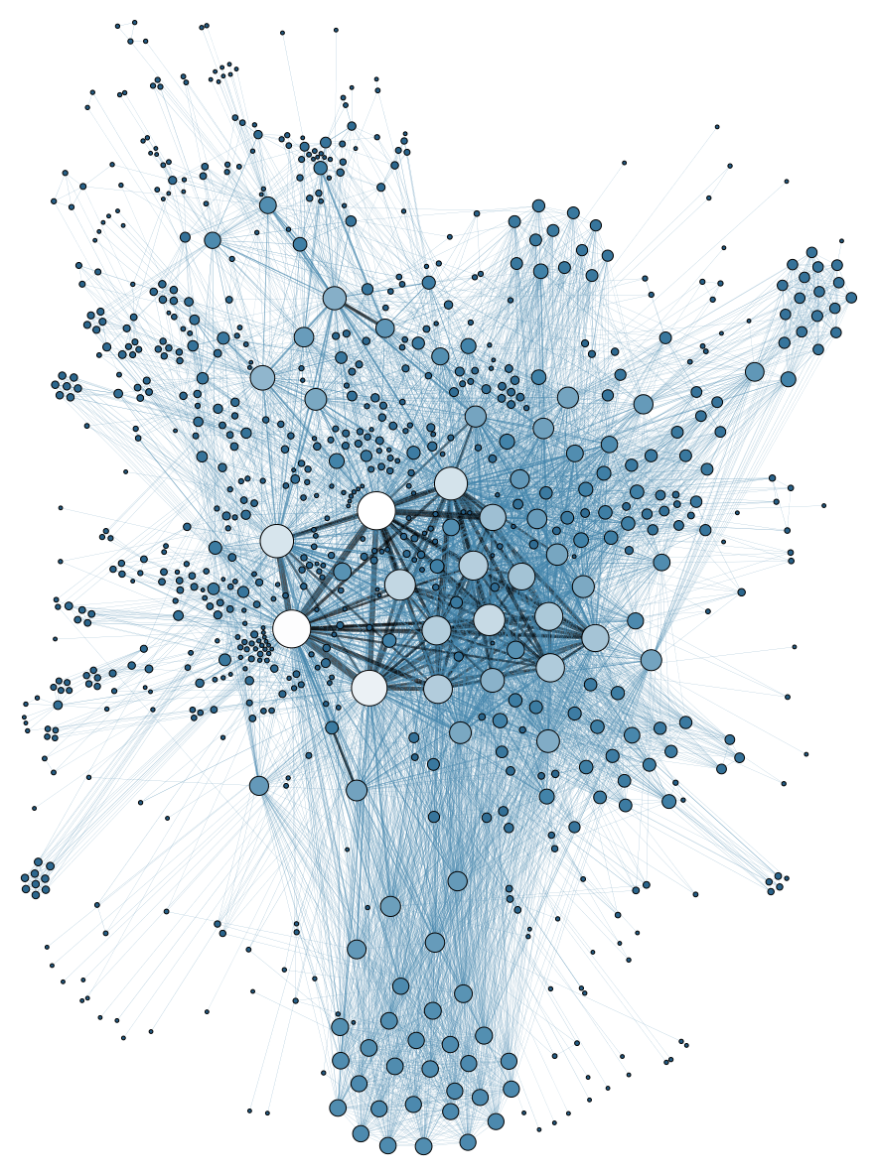
Algorithms & Complexity
I have a problem, how
fast can it be solved?
Here is an $O\left(n^{2}\right)$
algorithm
Your problem
is NP-hard
algorithm helpdesk
$O\left(n^{2}\right)$ is too slow on
my big data input

Slide 4
Algorithms & Complexity
algorithm helpdesk

Slide 5
Algorithms & Complexity
Can my $O\left(n^{2}\right)$-algorithm
be improved?
Yes, here is an
$O\left(n\right)$algorithm
algorithm helpdesk

Slide 6
Algorithms & Complexity
Can my $O\left(n^{2}\right)$-algorithm
be improved?
Yes, here is an
$O\left(n\right)$algorithm
No, this is unlikely
algorithm helpdesk
- Exploit input structure (e.g. parameterized algorithms)
- Relax goal (e.g. approximation algorithms)
- Resort to heuristics
- Adapt the model

Slide 7
Algorithms & Complexity
Can my $O\left(n^{2}\right)$-algorithm
be improved?
I don’t know.
Yes, here is an
$O\left(n\right)$algorithm
No, this is unlikely
algorithm helpdesk
Standard tools for lower bounds are not applicable!
NP-hardness: too coarse, cannot distinguish $O\left(n\right)$ and $O\left(n^{100}\right)$
Unconditional lower bounds: stuck at time $O\left(n\log{n}\right)$

Slide 8
Algorithms & Complexity
Can my $O\left(n^{2}\right)$-algorithm
be improved?
I don’t know.
Yes, here is an
$O\left(n\right)$algorithm
No, this is unlikely
algorithm helpdesk
Standard tools for lower bounds are not applicable!
Can we find an analogue of NP-hardness within P?

Slide 9
Fine-Grained Complexity
Which barriers prevent subquadratic algorithms?
Consider a well-studied problem $P$:
Best known running time $O(n^{2})$
Conjecture that it has no $O(n^{1.999})$ algorithm
$$+$$
Relate another problem $Q$ to $P$ via a reduction
$$⟹$$
Conditional lower bound for $Q$

Slide 10
Fine-Grained Reductions
transfer hardness of problem $P$ to problem $Q$ by reductions
problem $P$
problem $Q$
reduction
instance $I$
instance $J$
$$r(n)$$
time
size $n$
size $s(n)$
Given instance $I$ of problem $P$ with size $n$
Construct an equivalent instance $J$ of problem $Q$ with size $s(n)$
Construction time: $r(n)$
If $s(n)$ and $r(n)$ are polynomials:
$P$ is $\text{NP}$-hard $⟹$ $Q$ is $\text{NP}$-hard

Slide 11
Fine-Grained Reductions
transfer hardness of problem $P$ to problem $Q$ by reductions
problem $P$
problem $Q$
reduction
instance $I$
instance $J$
$$r(n)$$
time
size $n$
size $s(n)$
$t(n)$ algorithm for $Q$ $⟹$ $r\left(n\right)+t(s\left(n\right))$ algorithm for $P$
E.g. if $P$ is conjectured to have no $O\left(n^{1.99}\right)$ algorithm and $r(n)=s(n)=O(n)$
$⟹$ $Q$ has no $O\left(n^{1.99}\right)$ algorithm under this conjecture

Slide 12
Core Problems
Which hard problem
to start from?
SAT:
given a formula in CNF on $n$ variables
is it satisfiable?
hypothesis: no $O({1.999}^{n})$ algorithm (SETH)
APSP:
given a weighted graph with $n$ vertices
compute the distance between any pair of vertices
hypothesis: no $O(n^{2.999})$ algorithm
3SUM:
given $n$ integers
do any three sum to $0$?
hypothesis: no $O(n^{1.999})$ algorithm

Slide 13
Landscape of Fine-Grained Complexity
3SUM-hard
SETH-hard
3SUM $n^{2}$
SETH
SAT $2^{n}$
[Abboud,B,Hermelin,Shabtay’19]
[Patrascu,
Williams’10]
[Gajentaan,Overmars’95]
[Williams’05]
SubsetSum $n+t$
X+Y $n^{2}$
GeomBase $n^{2}$
k-DomSet $n^{k}$
OV $n^{2}$
Colinear $n^{2}$
Separator $n^{2}$
[Backurs,Indyk’15]
[B’14]
Edit Distance $n^{2}$
Frechet $n^{2}$
PlanarMotion
Planning $n^{2}$
[B,Künnemann’15,Abboud,
Backurs,V-Williams’15]
[V-Williams,Roditty’13]
Diameter $n^{2}$
Dynamic Time Warping $n^{2}$
APSP-hard
[B,Künnemann’15,
Abboud,Backurs,
V-Williams’15]
[Impagliazzo]
APSP $n^{3}$
[V-Williams,
Williams’10]
LCS $n^{2}$
NFA-Acceptance $n^{2}$
[Backurs,Dikkala,
Tzamos’16]
Radius $n^{3}$
[B,Künnemann’15]
[Backurs,Indyk’16]
Longest Palindromic Subsequence $n^{2}$
RegExp Matching $n^{2}$
Maximum
Submatrix $n^{3}$
Metricity $n^{3}$
[B,Gawrychowski,
Mozes,Weimann’18]
Betweenness
Centrality $n^{3}$
Tree Edit
Distance $n^{3}$
NegTriangle $n^{3}$

Slide 14
Modern Algorithms & Complexity
Can my $O\left(n^{2}\right)$-algorithm
be improved?
I don’t know.
Yes, here is an
$O\left(n\right)$algorithm
No, this is unlikely
algorithm helpdesk

Slide 15
Modern Algorithms & Complexity
Fine-Grained Complexity
Can my $O\left(n^{2}\right)$-algorithm
be improved?
= characterization of exponent
of best-possible algorithm
Yes, here is an
$O\left(n\right)$algorithm
No, time $O\left(n^{1.99}\right)$ would yield a breakthrough:
algorithm helpdesk
Satisfiability from time $O(2^{n})$ to $O({1.999}^{n})$, or
All Pairs Shortest Paths from time $O(n^{3})$ to $O(n^{2.999})$, or …
>50-years-old questions

Slide 16
Near-Optimal Algorithms
Vision: near-optimal algorithms for fundamental computational problems
Algorithms
&
Complexity
$$+$$
Design efficient algorithm
running in time e.g. $O\left(n^{2}\right)$
Prove fine-grained lower bound ruling out time e.g. $O\left(n^{1.99}\right)$
Then $O\left(n^{2}\right)$ is the (near-)optimal time complexity*
*in the worst case, up to lower order factors,
and conditional on a conjecture

Slide 17
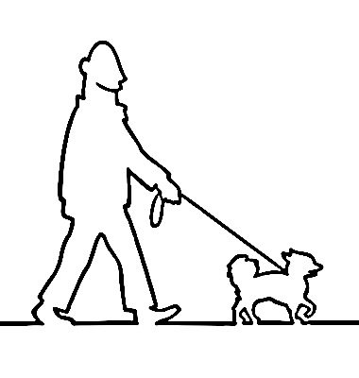
Showcase: Computational Geometry
Fréchet distance:
Is a similarity measure between polygonal curves
Can be computed in time $\tilde{O}(n^{2})$
[Alt,Godau’95]
but not in time $O\left(n^{2−ε}\right)$ assuming SETH
[B’14]
Further work on geometry:
dynamic time warping, Haussdorff distance, Earth Mover’s distance, curve simplification, geometric intersection graphs, …
[B’14, B,Mulzer’15, B,Künnemann’15, B,Cabello,Emmerich’17, Baldus,B’17, Abrahamsen,Adamaszek,B,Cohen-Addad,
Mehr,Rotenberg,Roytman,Thorup’18, B,Künnemann,Nusser’19, B,Chaudhury’19, B,Kisfaludi-Bak,Pilipczuk,van Leeuwen’19, B,Künnemann,Nusser’20, B,Nusser’21, B,Driemel,Nusser,Psarros’22, B,Kisfaludi-Bak,Künnemann,Nusser,Parsaeian’22, B,Kisfaludi-Bak,Künnemann,Marx,Nusser’22, B,Fischer,van der Hoog,Kipouridis,Kociumaka,Rotenberg’24]

Slide 18
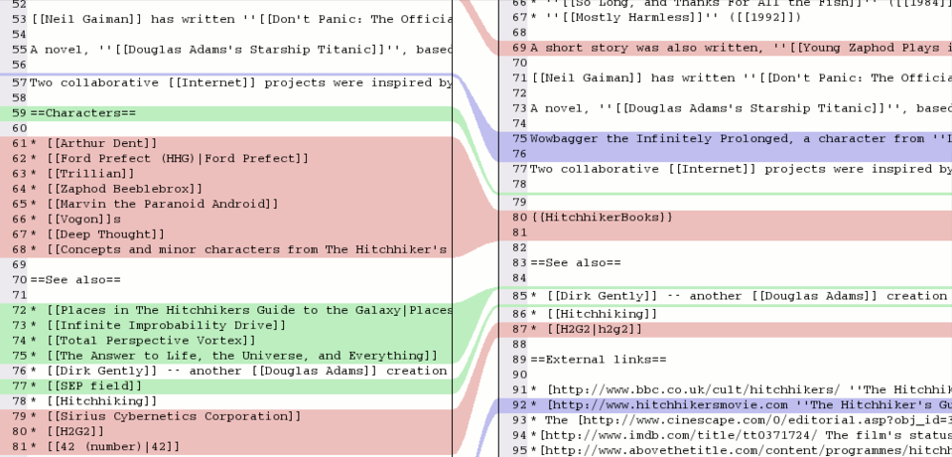
Showcase: String Algorithms
d | i | f | f | i | c | u | l | t | y
Longest Common Subsequence:
Given two strings $x,y$ of length $n$, compute the longest string $z$ that is a subsequence of both $x$ and $y$
i | n | d | u | s | t | r | y
e.g. diff tool used in git merge:

Slide 19
Showcase: String Algorithms
d | i | f | f | i | c | u | l | t | y
Longest Common Subsequence:
Given two strings $x,y$ of length $n$, compute the longest string $z$ that is a subsequence of both $x$ and $y$
i | n | d | u | s | t | r | y
Can be computed in time $O(n^{2})$
[Wagner,Fischer’74]
but not in time $O\left(n^{2−ε}\right)$ assuming SETH
[Abboud,Backurs,Vassilevska Williams‘15]
[B,Künnemann’15]
Further work on strings:
edit distance, language edit distance, regular expression matching,
approximation algorithms, sublinear algorithms, compressed strings, …
[B,Künnemann’15, B,Grandoni,Saha,Vassilevska Williams’16, B,Wellnitz’17, B,Grønlund,Green Larsen’17, Abboud,Backurs,B,Künnemann’17, B,Künnemann’18, Abboud,B’18, B,Chaudhury’18, B,Künnemann,Wellnitz’19,
B,Cohen-Addad,Das’21, B,Cassis,Fischer,Nakos’22, B,Cassis,Fischer,Nakos’22, B,Cassis,Fischer,Kociumaka’24]

Slide 20
A Hard Problem
Orthogonal Vectors Problem
Given sets $A,B⊆{\left\{0,1\right\}}^{d}$ of size $n$
Decide whether there are $a∈A,b∈B$ such that
for all $i∈\left\{1,…,d\right\}: a\left[i\right]=0$ or $b\left[i\right]=0$ (we write: $a⊥b$)
$A$:
0 | 1 | 1 | 0 | 1
$B$:
1 | 0 | 1 | 1 | 1
1 | 0 | 1 | 0 | 1
1 | 0 | 1 | 1 | 0
1 | 1 | 1 | 1 | 0
0 | 0 | 1 | 1 | 1
1 | 0 | 1 | 1 | 1
1 | 1 | 0 | 1 | 0
$$n=8$$
1 | 0 | 0 | 1 | 1
1 | 0 | 0 | 0 | 1
0 | 1 | 1 | 1 | 1
0 | 0 | 1 | 0 | 1
1 | 1 | 1 | 0 | 1
1 | 1 | 0 | 0 | 0
1 | 0 | 0 | 1 | 0
1 | 0 | 0 | 1 | 0
$$d=5$$

Slide 21
A Hard Problem
Orthogonal Vectors Problem
Given sets $A,B⊆{\left\{0,1\right\}}^{d}$ of size $n$
Decide whether there are $a∈A,b∈B$ such that
for all $i∈\left\{1,…,d\right\}: a\left[i\right]=0$ or $b\left[i\right]=0$ (we write: $a⊥b$)
$A$:
0 | 1 | 1 | 0 | 1
$B$:
1 | 0 | 1 | 1 | 1
1 | 0 | 1 | 0 | 1
1 | 0 | 1 | 1 | 0
1 | 1 | 1 | 1 | 0
0 | 0 | 1 | 1 | 1
1 | 0 | 1 | 1 | 1
1 | 1 | 0 | 1 | 0
$$n=8$$
1 | 0 | 0 | 1 | 1
1 | 0 | 0 | 0 | 1
0 | 1 | 1 | 1 | 1
0 | 0 | 1 | 0 | 1
1 | 1 | 1 | 0 | 1
1 | 1 | 0 | 0 | 0
1 | 0 | 0 | 1 | 0
1 | 0 | 0 | 1 | 0
$$d=5$$

Slide 22
A Hard Problem
Orthogonal Vectors Problem
Given sets $A,B⊆{\left\{0,1\right\}}^{d}$ of size $n$
Decide whether there are $a∈A,b∈B$ such that
for all $i∈\left\{1,…,d\right\}: a\left[i\right]=0$ or $b\left[i\right]=0$ (we write: $a⊥b$)
$A$:
0 | 1 | 1 | 0 | 1
$B$:
1 | 0 | 1 | 1 | 1
1 | 0 | 1 | 0 | 1
1 | 0 | 1 | 1 | 0
1 | 1 | 1 | 1 | 0
0 | 0 | 1 | 1 | 1
1 | 0 | 1 | 1 | 1
1 | 1 | 0 | 1 | 0
$$n=8$$
1 | 0 | 0 | 1 | 1
1 | 0 | 0 | 0 | 1
0 | 1 | 1 | 1 | 1
0 | 0 | 1 | 0 | 1
1 | 1 | 1 | 0 | 1
1 | 1 | 0 | 0 | 0
1 | 0 | 0 | 1 | 0
1 | 0 | 0 | 1 | 0
$$d=5$$

Slide 23
A Hard Problem
Orthogonal Vectors Problem
Given sets $A,B⊆{\left\{0,1\right\}}^{d}$ of size $n$
Decide whether there are $a∈A,b∈B$ such that
for all $i∈\left\{1,…,d\right\}: a\left[i\right]=0$ or $b\left[i\right]=0$ (we write: $a⊥b$)
Naive algorithm:
time $O\left(n^{2}d\right)$
Thm:
[Williams‘05]
The Orthogonal Vectors problem has no $O\left(n^{2−ε}d^{c}\right)$-time algorithm
for any $ε,c>0$ assuming SETH

Slide 24
Reduction from OV to LCS
Orthogonal Vectors
Longest Common Subsequence
Given strings $x,y$ of length $N$
compute length of their LCS
Given sets $A,B⊆{\left\{0,1\right\}}^{d}$ of size $n$
are there $a∈A,b∈B$ s.t. $a⊥b$?
$$N=O\left(nd^{2}\right)$$
Time $O\left(N^{2}\right)$ [Wagner,Fischer’74]
No $O\left(n^{2−ε}d^{c}\right)$ assuming SETH
$$⟹$$
No $O\left(N^{2−ε}\right)$ assuming SETH
[Williams‘05]
[B,Künnemann’15,
Abboud,Backurs,Vassilevksa-Williams ‘15]

Slide 25
Reduction from OV to LCS
Orthogonal Vectors
Longest Common Subsequence
Given strings $x,y$ of length $N$
compute length of their LCS
Given sets $A,B⊆{\left\{0,1\right\}}^{d}$ of size $n$
are there $a∈A,b∈B$ s.t. $a⊥b$?
$$N=O\left(nd^{2}\right)$$
Coordinate Gadget:
$$0^{A} :=001$$
$$1^{A} :=111$$
$$LCS=2$$
$$LCS=2$$
$$LCS=0$$
$$LCS=2$$
$$0^{B} :=011$$
$$1^{B} :=000$$
$$LCS\left(a_{i}^{A},b_{i}^{B}\right)=2−2a_{i}b_{i}$$

Slide 26
Reduction from OV to LCS
$$LCS\left(a_{i}^{A},b_{i}^{B}\right)=2−2a_{i}b_{i}$$
Orthogonal Vectors
Longest Common Subsequence
Given strings $x,y$ of length $N$
compute length of their LCS
Given sets $A,B⊆{\left\{0,1\right\}}^{d}$ of size $n$
are there $a∈A,b∈B$ s.t. $a⊥b$?
$$N=O\left(nd^{2}\right)$$
Vector Gadget:
length $2d$
$$VG^{′}\left(a\right) :=a_{1}^{A} 2…2 a_{2}^{A} 2…2 a_{3}^{A} 2…2 a_{4}^{A}$$
in the picture: $d=4$
$$VG^{′}\left(b\right) :=b_{1}^{B} 2…2 b_{2}^{B} 2…2 b_{3}^{B} 2…2 b_{4}^{B}$$
$LCS\left(VG^{′}\left(a\right),VG^{′}\left(b\right)\right)=\left(d−1\right)2d+\sum_{i=1}^{d}{(2−}2a_{i}b_{i})=2d^{2}−2\left\langle a,b\right\rangle$

Slide 27
Reduction from OV to LCS
$$LCS\left(VG^{′}\left(a\right),VG^{′}\left(b\right)\right)=2d^{2}−2\left\langle a,b\right\rangle$$
Orthogonal Vectors
Longest Common Subsequence
Given strings $x,y$ of length $N$
compute length of their LCS
Given sets $A,B⊆{\left\{0,1\right\}}^{d}$ of size $n$
are there $a∈A,b∈B$ s.t. $a⊥b$?
$$N=O\left(nd^{2}\right)$$
Normalized Vector Gadget:
length $2d^{2}−1$
$$VG\left(a\right) ≔ VG^{′}(a) 3…3$$
$$VG^{′}(a) 3…3$$
$$VG\left(b\right) ≔ 3…3 VG^{′}(b)$$
$$3…3 VG^{′}(b)$$
$$LCS\left(VG\left(a\right),VG\left(b\right)\right)=\left\{\begin{matrix}2d^{2} \\ 2d^{2}−1\end{matrix} \begin{aligned}if \left\langle a,b\right\rangle =0 \\ otherwise\end{aligned}\right.$$
$$C≔2d^{2}−1$$

Slide 28
Reduction from OV to LCS
$$LCS\left(VG\left(a\right),VG\left(b\right)\right)=\left\{\begin{matrix}C+1 \\ C\end{matrix} \begin{aligned}if \left\langle a,b\right\rangle =0 \\ otherwise\end{aligned}\right.$$
Orthogonal Vectors
Longest Common Subsequence
Given strings $x,y$ of length $N$
compute length of their LCS
Given sets $A,B⊆{\left\{0,1\right\}}^{d}$ of size $n$
are there $a∈A,b∈B$ s.t. $a⊥b$?
$$N=O\left(nd^{2}\right)$$
OR Gadget:
$$\#_{4}≔\left(2n−1\right)5d^{2}$$
in the picture: $n=3$
length $5d^{2}$
$$VG\left(A_{1}\right) 4…4 VG\left(A_{2}\right) 4…4 VG\left(A_{3}\right) 4…4 VG\left(A_{1}\right) 4…4 VG\left(A_{2}\right) 4…4 VG(A_{3})$$
$$4……………4 VG\left(B_{1}\right) 4…4 VG\left(B_{2}\right) 4…4 VG\left(B_{3}\right) 4……………4$$
length $5d^{2}⋅2n$
$LCS≥\#_{4}+nC+1$ iff there exists an orthogonal pair

Slide 29
Reduction from OV to LCS
Orthogonal Vectors
Longest Common Subsequence
Given strings $x,y$ of length $N$
compute length of their LCS
Given sets $A,B⊆{\left\{0,1\right\}}^{d}$ of size $n$
are there $a∈A,b∈B$ s.t. $a⊥b$?
$$N=O\left(nd^{2}\right)$$
Time $O\left(N^{2}\right)$ [Wagner,Fischer’74]
No $O\left(n^{2−ε}d^{c}\right)$ assuming SETH
$$⟹$$
No $O\left(N^{2−ε}\right)$ assuming SETH
[Williams‘05]
[B,Künnemann’15,
Abboud,Backurs,Vassilevksa-Williams ‘15]

Slide 30
Showcase: String Algorithms
d | i | f | f | i | c | u | l | t | y
Longest Common Subsequence:
Given two strings $x,y$ of length $n$, compute the longest string $z$ that is a subsequence of both $x$ and $y$
i | n | d | u | s | t | r | y
Can be computed in time $O(n^{2})$
[Wagner,Fischer’74]
but not in time $O\left(n^{2−ε}\right)$ assuming SETH
[Abboud,Backurs,Vassilevska Williams‘15]
[B,Künnemann’15]
Further work on strings:
edit distance, language edit distance, regular expression matching,
approximation algorithms, sublinear algorithms, compressed strings, …
[B,Künnemann’15, B,Grandoni,Saha,Vassilevska Williams’16, B,Wellnitz’17, B,Grønlund,Green Larsen’17, Abboud,Backurs,B,Künnemann’17, B,Künnemann’18, Abboud,B’18, B,Chaudhury’18, B,Künnemann,Wellnitz’19,
B,Cohen-Addad,Das’21, B,Cassis,Fischer,Nakos’22, B,Cassis,Fischer,Nakos’22, B,Cassis,Fischer,Kociumaka’24]

Slide 31
Showcase: Graph Algorithms
Tree Edit Distance:
Given two trees, transform one into the other using cheap edits
Weighted problem: Cost of an operation depends on the node labels

Slide 32
Showcase: Graph Algorithms
Tree Edit Distance:
Given two trees, transform one into the other using cheap edits
Can be computed in time $O(n^{6})$
[Tai’79]
Can be computed in time $O(n^{4})$
[Shasha,Zhang’89]
Can be computed in time $O(n^{3}\log{n})$
[Klein’98]
Can be computed in time $O(n^{3})$
[Demaine,Mozes,Rossman,Weimann’07]
but not in time $O\left(n^{3−ε}\right)$ assuming APSP-H
[B,Gawrychowski,Mozes,Weimann’18]
Further work on graphs:
shortest paths, transitive closure, diameter, random graphs, , …
[B,Sauerwald,Stauffer,Sun’14, B,Friedrich,Krohmer’14, B,Hermelin,Mnich,van Leeuwen’15, B,Friedrich,Hoefer,Rothenberger,Sauerwald’15, B,Hansen,Krinninger’17, B,Keusch,Lengler,Maus,Molla’17, B,Keusch,Lengler’17, B,Krinninger’17, B,Gawrychowski,Mozes,Weimann’18, B,Husfeldt,Magnusson’18, B,Künnemann,Węgrzycki’19, B,Slusallek’21, Abboud,B,Khoury,Zamir’22, Abboud,B,Fischer’23, B,Cassis,Fischer’23, Abboud,B,Fischer,Künnemann’24, B,Grønlund,Künnemann,Green Larsen’24]

Slide 33
Showcase: Optimization
$$t=19$$
Subset Sum:
Given a set $X$ of $n$ positive integers and a target $t$
is there a subset $Y$ of $X$ summing to exactly $t$?
$$X=\{2,5,6,11,15\}$$
$$Y=\{2,5,6,11,15\}$$
Can be solved in time $O(nt)$
[Bellman’57]
Can be solved in time $\tilde{O}(\sqrt{n}⋅t)$
[Koiliaris,Xu’17]
Can be solved in time $\tilde{O}\left(t\right) = O(t\log^{4}{t}\log{n})$
[B’17]
Can be solved in time $\tilde{O}\left(t\right) = O(t\log{t})$
[Jin,Wu’19]
but not in time $2^{o(n)}⋅t^{0.999}$ assuming SETH
[Abboud,B,Hermelin,Shabtay’19]
Further work on optimization:
Knapsack, Partition, scheduling, approximation, other parameters, …
[B’17, Abboud,B,Hermelin,Shabtay’19, B,Nakos’20, B,Fischer,Hermelin,Shabtay,Wellnitz’20, Abboud,B,Hermelin,Shabtay’20, Axiotis,Backurs,B,Jin,Nakos,Tzamos,Wu’21, B,Wellnitz’21, B,Fischer,Nakos’21, B,Nakos’21, B,Fischer,Nakos’22, B,Cassis’22, B,Cassis’23, B’24]
ERC Starting Grant

Slide 34
Near-Optimal Algorithms
Vision: near-optimal algorithms for fundamental computational problems
Algorithms
&
Complexity
$$+$$
Design efficient algorithm
running in time e.g. $O\left(n^{2}\right)$
Prove fine-grained lower bound ruling out time e.g. $O\left(n^{1.99}\right)$
Then $O\left(n^{2}\right)$ is the (near-)optimal time complexity*
*in the worst case, up to lower order factors,
and conditional on a conjecture

